Slide 1

Statistical Modeling to Predict Student’s Dropout and Academic Success
Project Team:
James Kibiro
Joshua Balderas
Neelkumar Jayeshbhai Patel

Slide 2

Project Motivation and Research Questions
Why this topic?
Key study questions
Student dropout and academic failure have high costs for students and institutions:
lost tuition revenue
delayed career progress
lower graduation and retention rates
What are the biggest contributors to student dropout and academic failure?
Can we predict whether a student will drop out, remain enrolled, or graduate?
Can we predict dropout using only first-semester data?
How does enrollment age affect graduation likelihood?
Using data-inclined approaches, Universities can:
Boost Graduation Rates
Optimize Resource Allocations
Develop Evidence-Based Policies

Slide 3
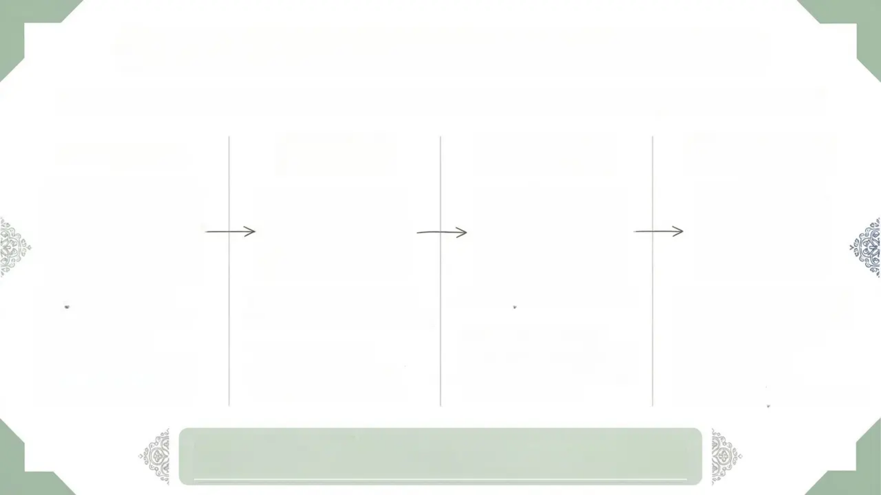
Comprehensive Dataset Overview 4,424 Student Records • Polytechnic Institute of Portalegre • 2008-2019
Macroeconomics
Demographics
ACADEMIC PERFORMANCE
Socioeconomic status
Age at enrollment
Gender Distribution
Marital Status
National Diversity
First Year metrics
Course Completion Rates
Grade Averages
Evaluation Outcomes
Family Occupation
Family Education Levels
Financial Aid Status
Scholarship Recipients
Debt indicators
National Unemployment Rates
Inflation
GDP
Data Source: UCI Machine Learning Repository

Slide 4

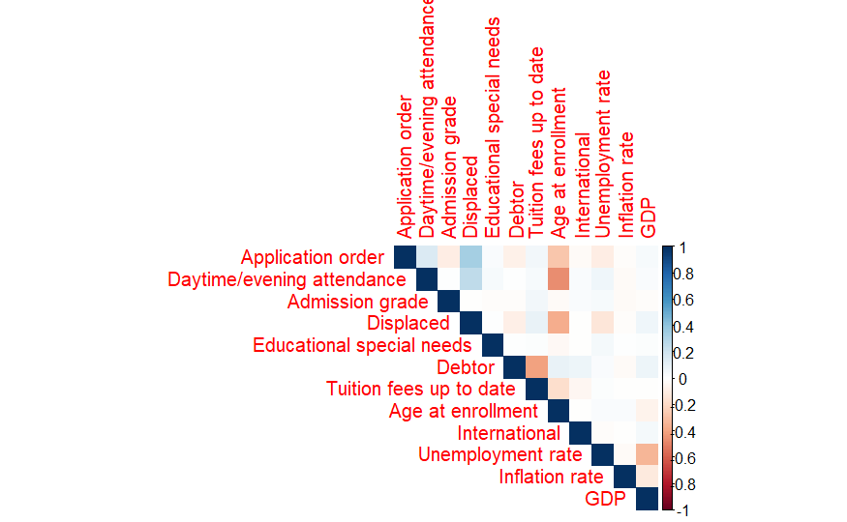
Variable Inspection – Correlation Matrix

Slide 5
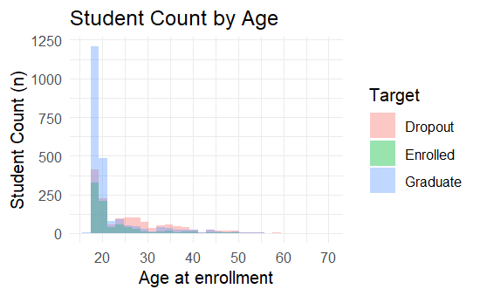
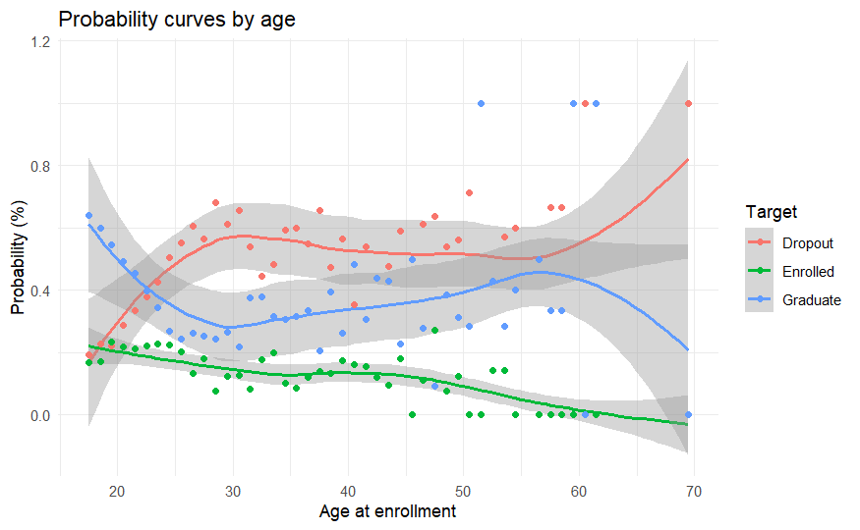
Variable Inspection – Nonlinearity in Age

Slide 6
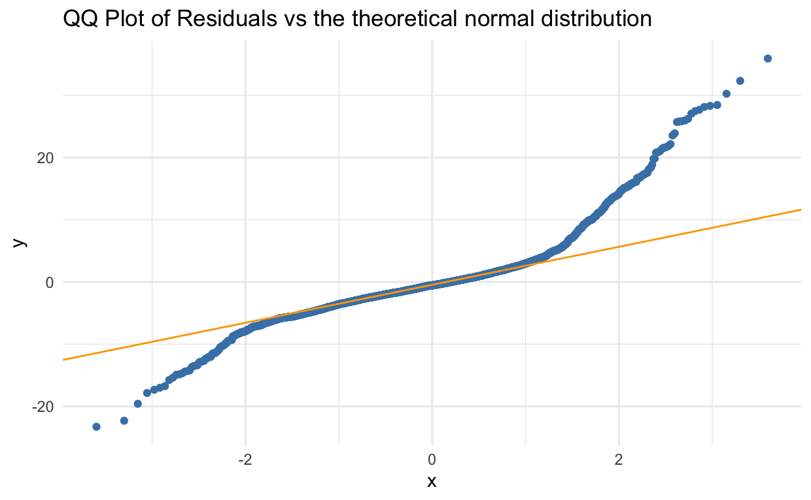
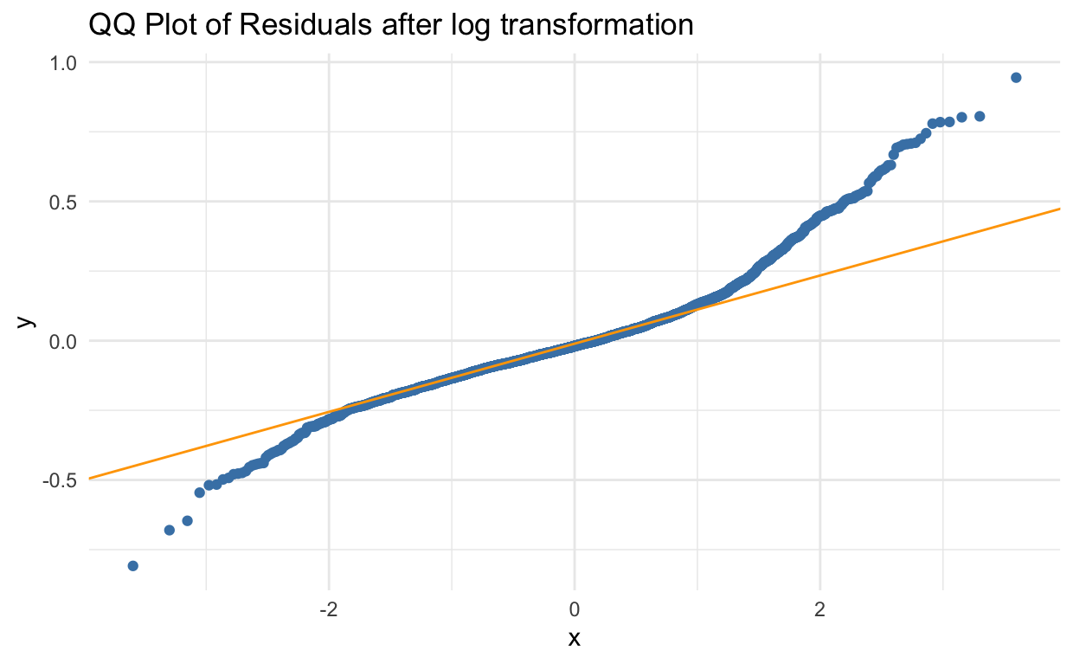
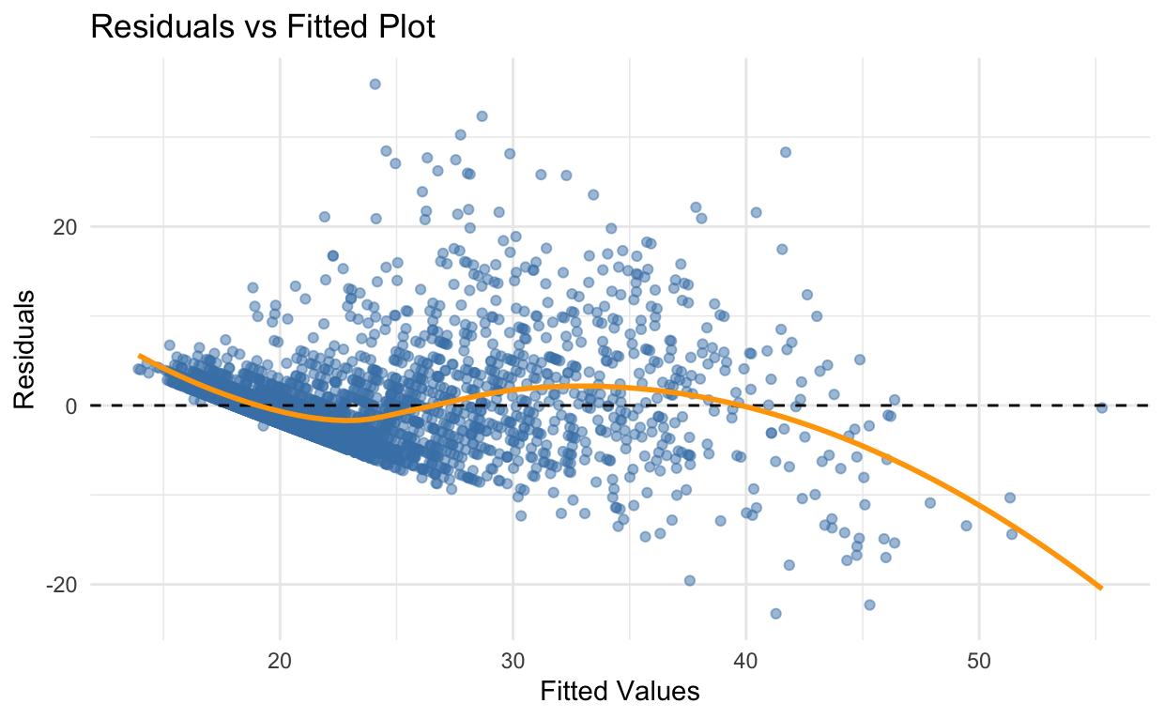
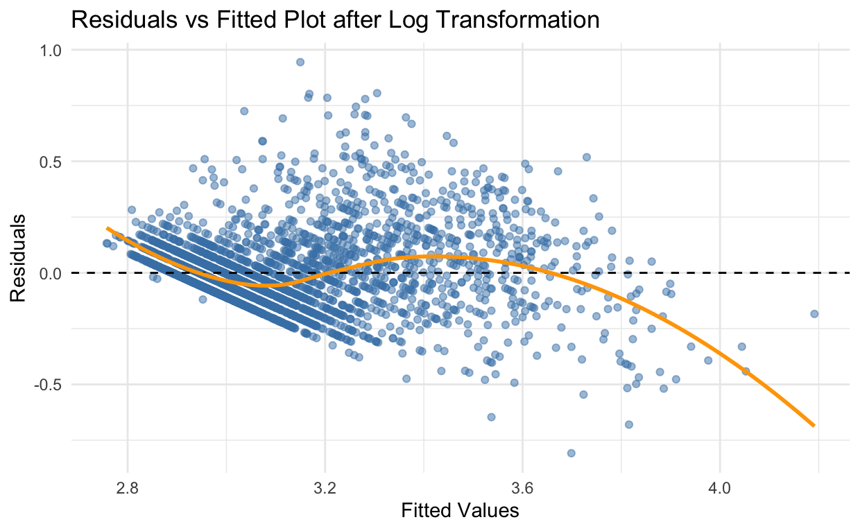
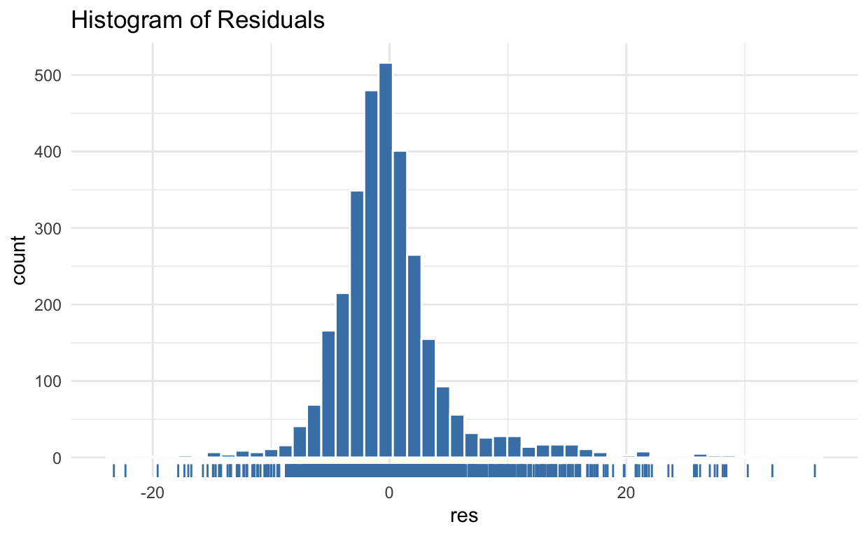
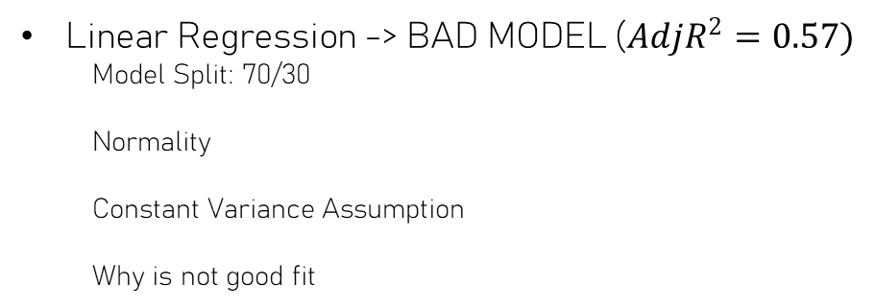
Methods: Multi Linear Regression
NOT A GOOD MODEL OF CHOICE
Linear Regression -> BAD MODEL ($AdjR^{2}=0.57)$
Model Split: 70/30
Normality
Constant Variance Assumption
Why is not good fit

Slide 7

Current State of Knowledge
Yakubu et al. (2025) – “Applying Machine Learning Approach to Predict Students’ Performance in Higher Educational Institutions”.
Fahd et al. (2022) – “Application of Machine Learning in Higher Education to Assess Student Academic Performance, at-risk, and Attrition”.
Tan & Shao (2015) – “Prediction of Student Dropout using Random Forest on 165,715 High School Students”.

Slide 8
Next Steps: Potential Models & Rationale
Logistic Regression
Estimate the probability that a student belongs to each outcome category.
Interpretable baseline showing how variables affect outcome probability.
Decision Tree
Predicts outcomes by splitting students into groups based on independent values.
Understandable rules for identifying at-risk students.

